Slide 1
Optimal Parameters of Limit Orders in High Frequency Market Making Strategy
Faculty of Computer Science
Master of Data Science
Moscow
2022

Slide 2
Introduction. Task definition
Master of Data Science
Optimal Parameters of Limit Orders in High Frequency Market Making Strategy
Introduction.
Price Graph
Limit Order Book
Market maker provides liquidity, by setting buy and sell limit orders.
Base requirements:
Be in market most of time
Limit orders only
Both side orders simultaneously
Not far from medium price (spread limit)
WHERE IS BETTER TO SET LIMIT ORDERS?

Slide 3
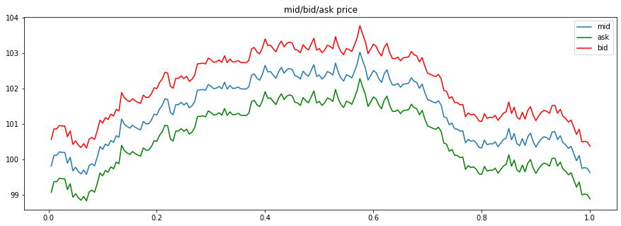
Simple (benchmark) strategy
Master of Data Science
Optimal Parameters of Limit Orders in High Frequency Market Making Strategy
Introduction
Fix distance from current mid price.
𝑝_{𝑏id} = mid – spread/2
𝑝_{ask} = mid + spread/2
𝑠𝑝𝑟𝑒𝑎𝑑 = 𝑐𝑜𝑛𝑠𝑡
(δ_{bid} = δ_{ask} = spread/2)
We use this strategy as a benchmark
δ_{ask}
δ_{bid}
mid
p_{bid}
mid or medium price is average of current best bid and best ask prices

Slide 4
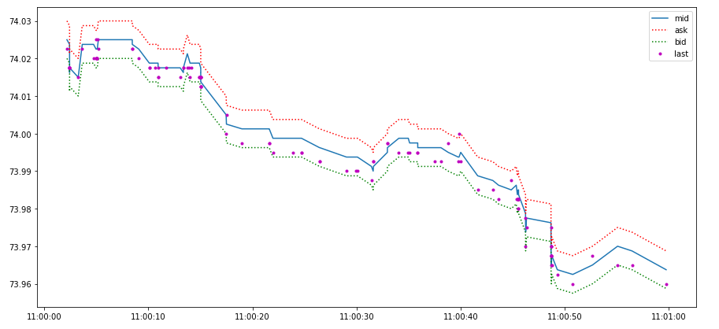
Inventory risk
Master of Data Science
Optimal Parameters of Limit Orders in High Frequency Market Making Strategy
Introduction
1 minute of trades, 7 Jul 21, 11:00-11:01
Risk of adverse price movement having large inventory
Example for benchmark strategy with spread 0.01 RUB
11 buys – 2 sells = +9

Slide 5


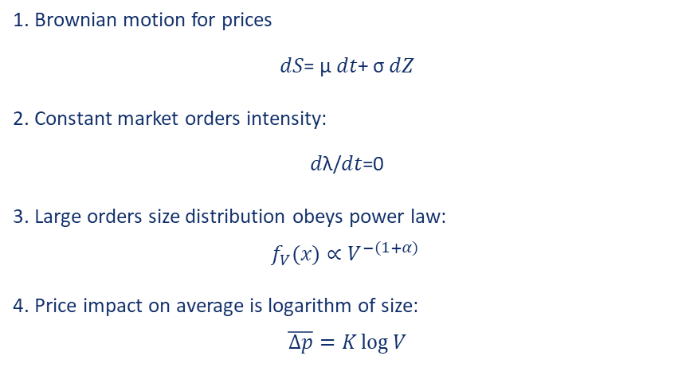
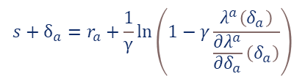
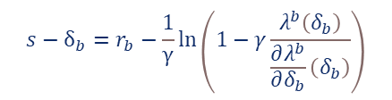
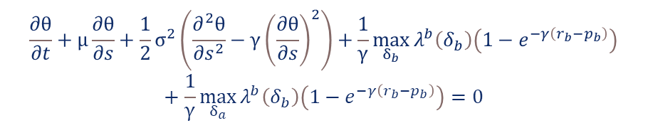
Model description and base assumptions
Master of Data Science
Optimal Parameters of Limit Orders in High Frequency Market Making Strategy
Model description
$$\max_{δ_{b},δ_{a}}{E}\left[−e^{−γ∗{(x_{T}+q_{T}s}_{T})}\right]$$
Maximize expected exponential utility of final wealth choosing optimal prices for limit orders
1. Brownian motion for prices
𝑑𝑆= μ 𝑑𝑡+ σ 𝑑𝑍
2. Constant market orders intensity:
𝑑λ/𝑑𝑡=0
3. Large orders size distribution obeys power law:
$$f_{V}(x)∝V^{−(1+α)}$$
4. Price impact on average is logarithm of size:
$$\overline{Δp}=K\log{V}$$
$$\frac{∂θ}{∂t}+μ\frac{∂θ}{∂s}+\frac{1}{2}σ^{2}\left(\frac{∂^{2}θ}{∂s^{2}}−γ{\left(\frac{∂θ}{∂s}\right)}^{2}\right)+\frac{1}{γ}\max_{δ_{b}}{λ^{b}\left(δ_{b}\right)\left(1−e^{−γ\left(r_{b}−p_{b}\right)}\right)}+\frac{1}{γ}\max_{δ_{a}}{λ^{b}\left(δ_{b}\right)\left(1−e^{−γ\left(r_{b}−p_{b}\right)}\right)}=0$$
𝜃(q, s, t) = qs.
$$s−δ_{b}=r_{b}−\frac{1}{γ}\ln\left(1−γ\frac{λ^{b}\left(δ_{b}\right)}{\frac{∂λ^{b}}{∂δ_{b}}\left(δ_{b}\right)}\right)$$
$$s+δ_{a}=r_{a}+\frac{1}{γ}\ln\left(1−γ\frac{λ^{a}\left(δ_{a}\right)}{\frac{∂λ^{a}}{∂δ_{a}}\left(δ_{a}\right)}\right)$$
Avellaneda, M., Stoikov S. High-frequency trading in a limit order book. Quantitative Finance, 2008
Ho, T. and Stoll, H., Optimal dealer pricing under transactions and return uncertainty. Journal of Financial Economics, 1981
where p_{b} = s - $δ_{b}$, p_{a} = s + $δ_{a}$

Slide 6
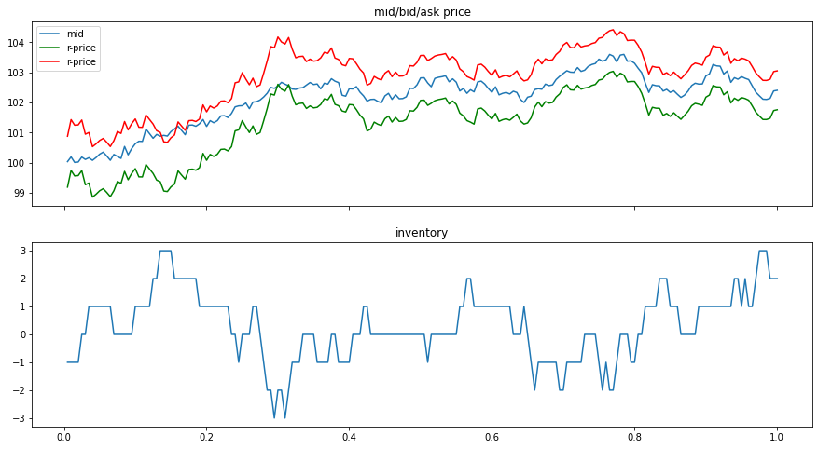
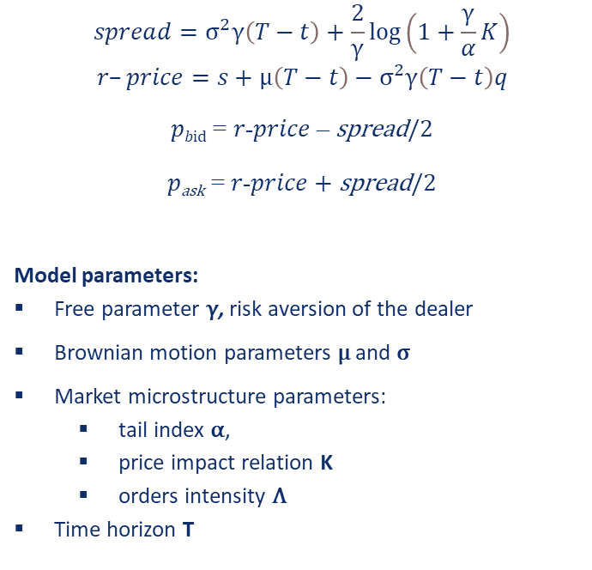
Model solution and parameters
Master of Data Science
Optimal Parameters of Limit Orders in High Frequency Market Making Strategy
Model description
Shifts spread up when inventory is low
$$spread=σ^{2}γ\left(T−t\right)+\frac{2}{γ}\log\left(1+\frac{γ}{α}K\right)$$
$$r–price=s+μ\left(T−t\right)−σ^{2}γ\left(T−t\right)q$$
𝑝_{𝑏id} = 𝑟-𝑝𝑟𝑖𝑐𝑒 – spread/2
𝑝_{ask} = 𝑟-𝑝𝑟𝑖𝑐𝑒 + spread/2
Model parameters:
Free parameter γ, risk aversion of the dealer
Brownian motion parameters μ and σ
Market microstructure parameters:
tail index α,
price impact relation K
orders intensity Λ
Time horizon T
Shifts spread down when inventory is high

Slide 7
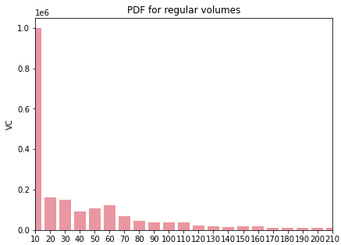
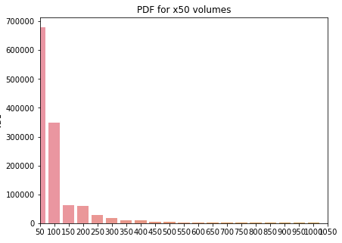
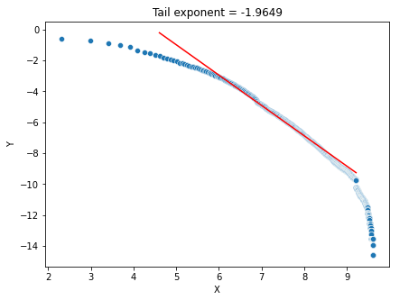
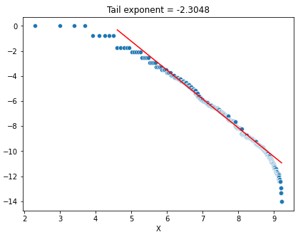
Market microstructure parameters Order size distribution
Master of Data Science
Optimal Parameters of Limit Orders in High Frequency Market Making Strategy
Market microstructure parameters
Log-log scale regression on complement CDF (tail distribution function):
log⁡ 𝑃 (𝑉 > 𝑥) = −𝛼 log⁡ 𝑥 + 𝑐
Regression results
R-squared | 0.991
F-statistics | 5.3e4
P-value (F-statistics) | 0.00
Slope (-α) | -1.995
t-statistic for slope | -230.5
P-value (slope) | 0.00
Regular orders
Factor of 50 orders
Maslow, S. and Mills, M., Price fluctuations from the order book perspective: empirical facts and a simple model. Physica A, 2001

Slide 8
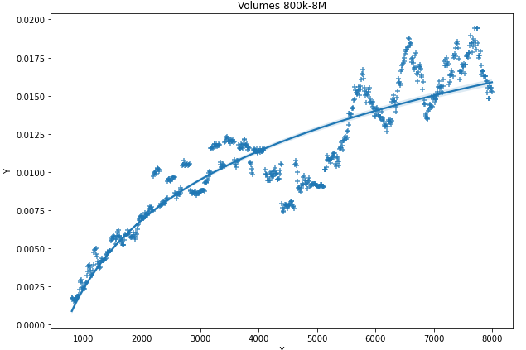
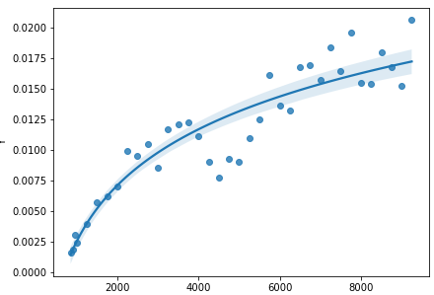
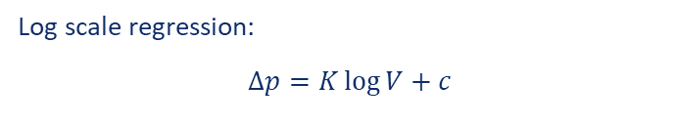
Market microstructure parameters Price impact
Master of Data Science
Optimal Parameters of Limit Orders in High Frequency Market Making Strategy
Market microstructure parameters
Log scale regression:
$Δp{=K\log{V}+c}$
Regression results
R-squared | 0.819
F-statistics | 3250
P-value (F-statistics) | 0.00
Slope (-α) | 0.0067
t-statistic for slope | 57
P-value (slope) | 0.00
Maslow, S. and Mills, M., Price fluctuations from the order book perspective: empirical facts and a simple model. Physica A, 2001
Factor of 50 orders only

Slide 9
Market microstructure parameters Summary
Master of Data Science
Optimal Parameters of Limit Orders in High Frequency Market Making Strategy
Market microstructure parameters
USD/RUB TOM
μ (drift) | 0.0
σ (std dev, daily basis) | 0.49
α (tail index) | 2.0
K (impact scale) | 0.0067
Λ (order frequency per hour) | 2300
EUR/RUB TOM
μ (drift) | 0.0
σ (std dev, daily basis) | 0.76
α (tail index) | 2.0
K (impact scale) | 0.0114
Λ (order frequency per hour) | 400
Maslow, S. and Mills, M., Price fluctuations from the order book perspective: empirical facts and a simple model. Physica A, 2001
Factor of 50 orders only

Slide 10
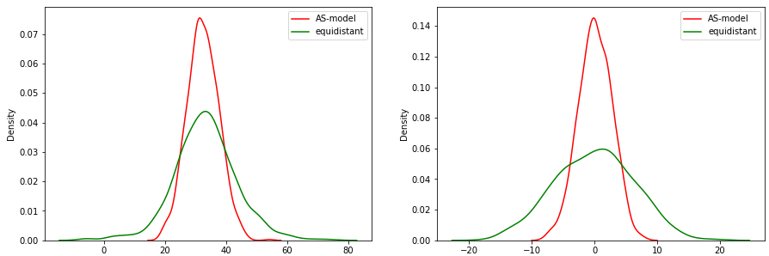
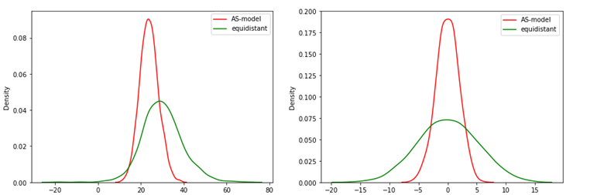
Simple simulation. Strategies comparison
Master of Data Science
Optimal Parameters of Limit Orders in High Frequency Market Making Strategy
Simulations
γ=0.1
Concentrated profit
Concentrated final inventory
Comparable means
γ increase makes strategy more conservative
Final profit
Final inventory
γ=0.5

Slide 11
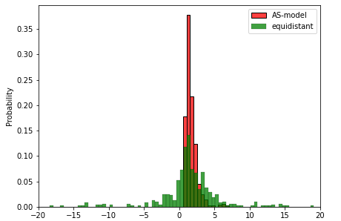
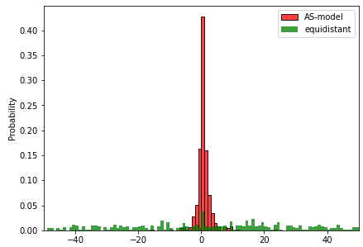
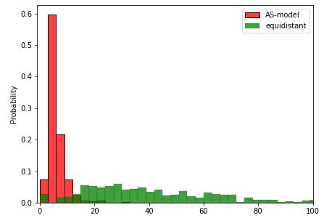
Master of Data Science
Optimal Parameters of Limit Orders in High Frequency Market Making Strategy
Simlulations
Historical simulation, USD/RUB (Feb-Oct 2021).
Final profit
Final inventory
Maximum inventory
Simulation results | Average spread | Mean PL | Std dev PL | Mean N | Mean final Q | Std dev final Q | Mean PL/deal | STD dev PL/deal
AS model strategy | 0.010 | 1.28 | 0.62 | 693 | 0.35 | 3.0 | 0.0019 | 0.0003
Benchmark (simple) strategy | 0.011 | 1.68 | 7.16 | 524 | 9.80 | 100.1 | 0.0041 | 0.0079

Slide 12
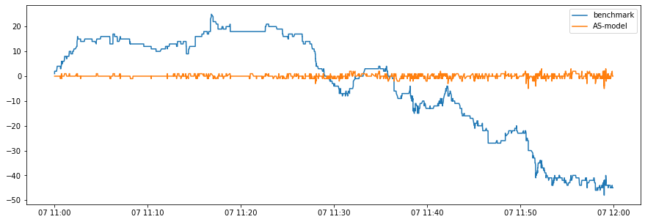
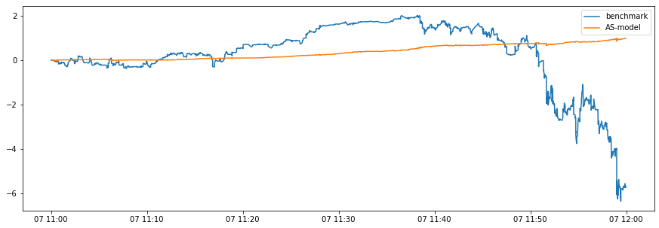
Sample equity and inventory trace
Optimal Parameters of Limit Orders in High Frequency Market Making Strategy
Simulations
7’Jul 2021, 11.00-12.00
Equal average spread
Benchmark strategy has huge exposure to market, so profit depends on price movements
AS-model strategy manage inventory much more effective: inventory is close to zero
Inventory
Profit

Slide 13
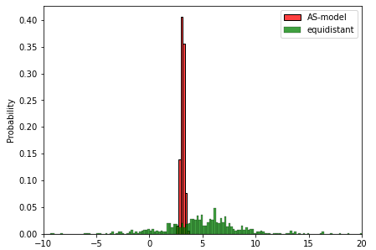
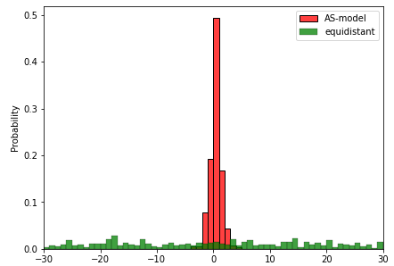
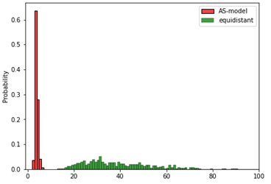
Master of Data Science
Optimal Parameters of Limit Orders in High Frequency Market Making Strategy
Simulations
Generated data, USD/RUB.
Final profit
Final inventory
Maximum inventory
Simulation results | Average spread | Mean PL | Std dev PL | Mean N | Mean final Q | Std dev final Q | Mean PL/deal | STD dev PL/deal
AS model strategy | 0.012 | 3.1 | 0.17 | 1014 | -0.09 | 1.1 | 0.0031 | 0.0001
Benchmark (simple) strategy | 0.011 | 5.0 | 4.00 | 986 | -0.68 | 30.0 | 0.0050 | 0.0041

Slide 14
CONCLUSIONS AND FURTHER RESEARCH NOTES
Master of Data Science
Optimal Parameters of Limit Orders in High Frequency Market Making Strategy
Conclusions
Model is much less risky with comparable average profits
Simple analytical solution, easy to implement
Plenty of assumptions about market
Doesn’t consider transaction costs
Doesn’t consider partial execution and impact of limit orders on price
FURTHER STEPS
Test on real market
Improve simulation with considering partial order execution and transaction costs
Improve data generation with fractal Brownian motion instead of simple one.
Model for volatility prediction
Model for order frequency prediction

Slide 15
THANK YOU FOR YOUR ATTENTION
Master of Data Science
Optimal Parameters of Limit Orders in High Frequency Market Making Strategy
Final
GitHub: https://github.com/rasharp/FinalMDS
https://github.com/rasharp/FinalMDS/blob/master/Thesis%20report.ipynb
E-mail: sharp.ra@gmail.com
Model description paper: https://www.math.nyu.edu/~avellane/HighFrequencyTrading.pdf

Slide 16
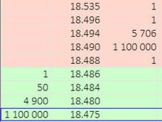
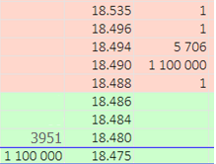
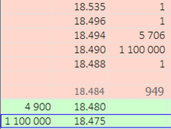
Order execution and price impact example
Optimal Parameters of Limit Orders in High Frequency Market Making Strategy
Appendix
AFTER MARKET ORDER
SELL 1000
AFTER LIMIT ORDER
SELL 1000 @18.484
LOB before deal
Δp = 0.006 = 6 ticks
Δp = 0.002 = 2 ticks
BUY 1 @ 18.486
BUY 50 @ 18.484
BUY 949 @ 18.480
BUY 1 @ 18.486
BUY 50 @ 18.484

Slide 17
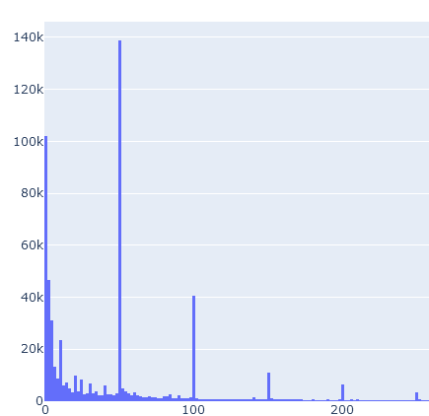
Order size distribution Split into components
Master of Data Science
Optimal Parameters of Limit Orders in High Frequency Market Making Strategy
Market microstructure parameters
continuous
discrete
Regular orders
Factor of 50 orders

Slide 18
Master of Data Science
Optimal Parameters of Limit Orders in High Frequency Market Making Strategy
Appendix
Data generation algorithm
Poisson process with intensity Λ to generate moments of market order events.
With P_{buy} probability new market order is buy order (rounded to 50%)
With P_{x50} probability new market order is factor of 50 order (36% based on historical data)
Use empirical PDF (KDE) for regular orders, empirical PMF for x50 orders
Brownian motion for mid price evolution
Brownian motion parameters: σ = 0.17, μ = 0
Market microstructure parameters: α = 2.0, K = 0.0067
Spread for benchmark strategy is equal to 4 ticks.
Risk aversion γ = 0.2.

